Slide 1
GWU Data Science Capstone Harry Newton
Faculty Advisor: Dr. Amir H. Jafari
Journal Title: Using Remote Sensing Big Data to Combat Forced Labor

Slide 2
Problem Statement
Develop a tractable Big Data approach to aggregate millions of signals from ships to discern behavior across years of operations and compare that to typical operations of the same type of ship using Data Visualization
Extend the data sources to include imagery data which can corroborate and supplement the signals data.

Slide 3
Article Outline
1. Literature Review 2. AIS Analytic Model for ship behavior across seasons for risk factors 2. Data Visualization (DV) for risk factors 3. Joint AIS & Imagery Model 4. Conclusion and Future Enhancements

Slide 4
Literature Review
Park, J., Lee, J., Seto, K., Hochberg, T., Wong, B. A., Miller, N. A., … Kroodsma, D. A. (2020). Illuminating dark fishing fleets in North Korea. Science Advances, 6(30), eabb1197.
Snapir, B., Waine, T. W., & Biermann, L. (2019). Maritime vessel classification to monitor fisheries with SAR: Demonstration in the North Sea. Remote Sensing, 11(3).
Miller, N. A., Roan, A., Hochberg, T., Amos, J., & Kroodsma, D. A. (2018). Identifying global patterns of transshipment behavior. Frontiers in Marine Science, 5(JUL).
G. Rowlands, J. Brown, B. Soule, P. T. Boluda, A. D. Rogers, Satellite surveillance of fishing vessel activity in the ascension island exclusive economic zone and marine protected area Maritime Policy 101, 39–50 (2019).

Slide 5
Risk Factors & Analysis Approach
Risk Factor | Analysis Approach
Long voyages (possibly to avoid inspections or contact in ports) | Based on the ships identification number, separate the AIS observations into voyages between port visits. Determined which of the ships have voyages in the top quartile for their type.
Time Gaps between signals (going dark) | Within each voyage compute time deltas between signals. Assess risk for ships with average gaps in the top quartile for their vessel type
Distance Gaps between signals (misleading locations) | Within each voyage compute the distance delta between signals. Assess a risk for ships with average gaps in the top quartile for their vessel type
Flag of Convenience (future) | Registration in a country known to be lax on fishing operations
Notes:
I couldn’t do the flags because the data was anonymized

Slide 6
Data Sources
Data | Source
2011-2016 AIS data (28.5 million observations of about 350 ships) | Global Fishing Watch (GFW) Public Datasets in Google Cloud, which provides a sample of 28.5M AIS signals and anonymized information on the associated vessels.
2017-2018 AIS data | Global Fishing Watch (GFW) “Dark Fleet” Public Datasets in Google Cloud, which cover individual AIS signals and information on the categories of vessels.
Sentinel-2 Satellite Imagery | From Copernicus (European Space Agency) and where not found there, from Google Cloud Public Data
Sentinel-2 Index | Google Cloud Public Data
AIS Vessel Reports (future) | Via the Spire AIS Vessel API

Slide 7
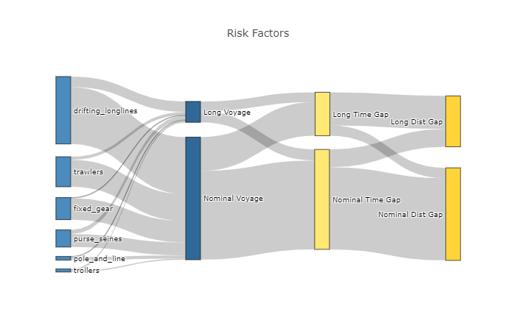
AIS Model Results & Visualization
Ship Index | Mmsi | Type | risk-score
4 | 5020143137211 | Trawlers | 3
33 | 23593130178765 | drifting_longlines | 3
81 | 63716389910332 | purse_seines | 3
94 | 77261928739173 | Trawlers | 3
120 | 89110306461984 | drifting_longlines | 3
135 | 102111574707951 | drifting_longlines | 3
153 | 110014060911622 | trawlers | 3
171 | 125954407820672 | trollers | 3
271 | 207595838999742 | drifting_longlines | 3
284 | 218997104404214 | trawlers | 3
Table 3 Ships with behavior on all risk factors
Figure 4 Sankey - risk factor proportions

Slide 8
Model 2 - Joint AIS & Imagery
Sentinel-2 images areas near NK fishing zone every couple of days in daylight and gives color images showing all ships not covered by clouds. Not often tasked over oceans.
AIS data from GFW gives all-weather, continuous time, location, and identity information for ships equipped. In EU & US, ships >15m or >65 ft are required to have use AIS.
Radar offers a compromise between these but we didn’t use. See the references for a specialized paper.
Imagery and AIS data can be joined based on the location and time data stored in each.
Data | Time | Location
AIS | Timestamp signal sent | Lat-lon of ship at signal
Imagery | Sensing Time for entire image | Lat-lon corners of processed image tiles
Notes:
Each country is able to set their rules for AIS use for vessels “flagged” by them, and are expected in the near future to regulate AIS use when in their waters. The International Maritime Organization –the appropriate United Nations body—mandates AIS use for all vessels > 500GT or a passenger vessel or >300GT on an international voyage.

Slide 9
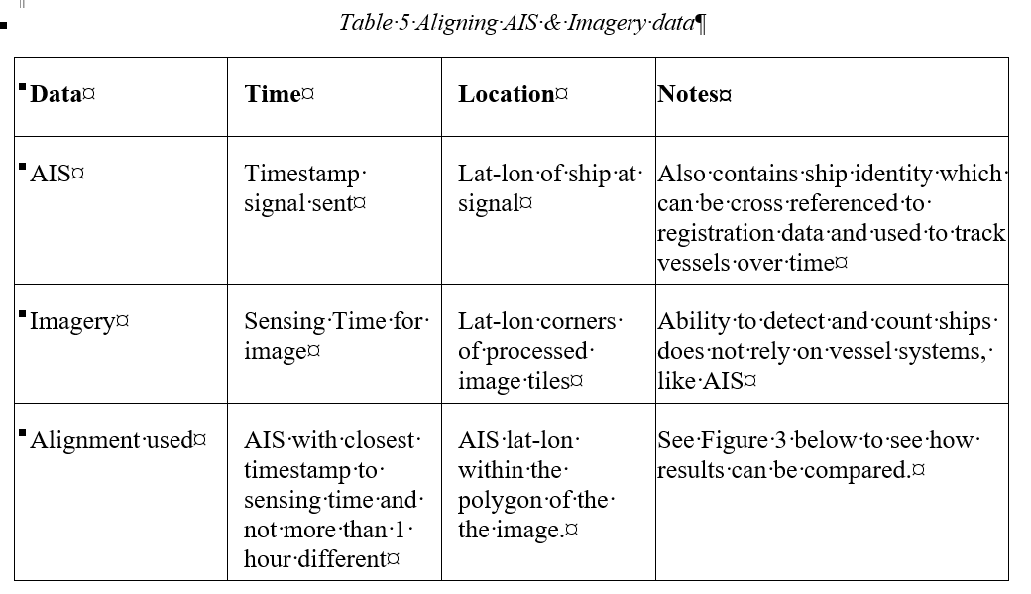
Aligning AIS & Imagery Data
In Google Datalab
1. Connect to ESA for Sentinel-2 imagery and filter for NK, <10 clouds, Dec 2018
2. Connect to GFW for AIS data and filter to same area & timeframe
3. Match signal with time & box of images
4. Retrieve images & signals

Slide 10
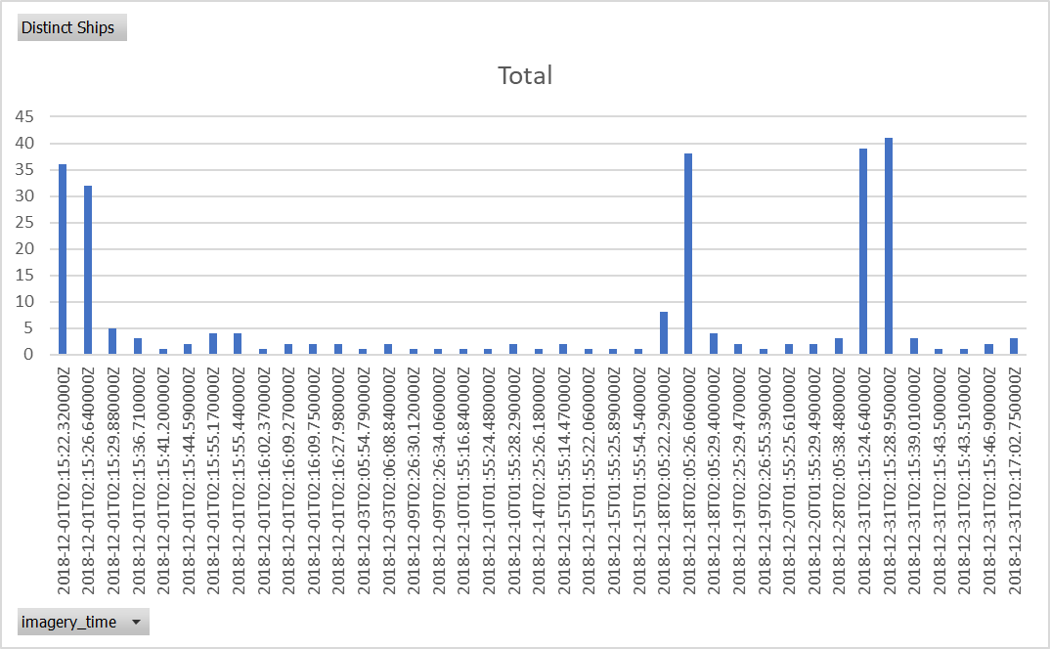
Images w/ co-incident Signals (Count of Distinct Ships)

Slide 11
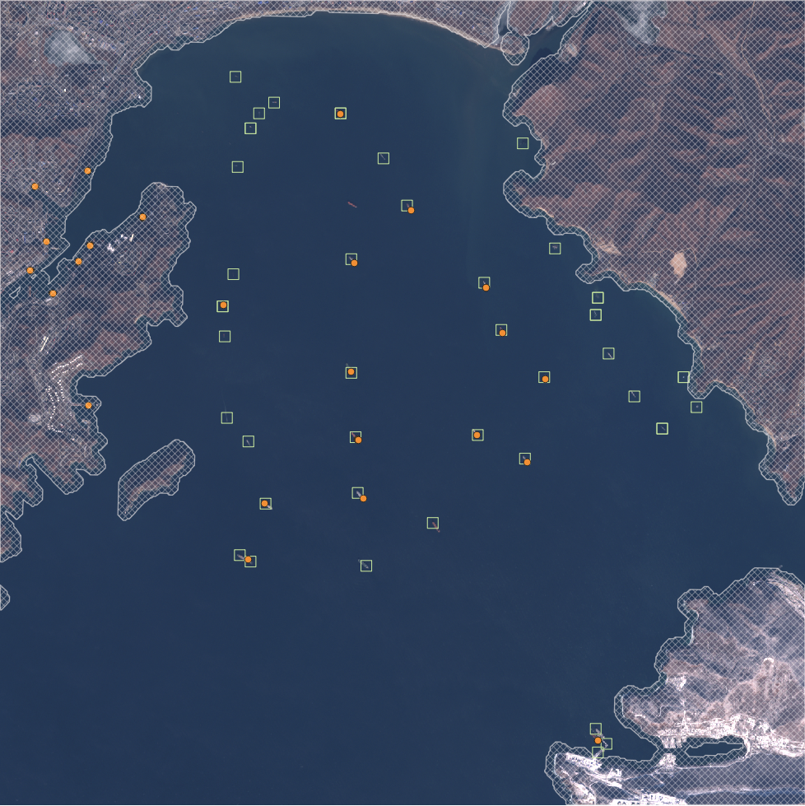
Results of Combined Model AIS signals Visual Detections

Slide 12
Conclusions and Future Directions
We demonstrated that Remote Sensing + Big Data in public datasets offers new potential for studying global problems like illegal fishing & forced labor
To increase understanding of these problems and motivate international forums like the U.N.
To empower governments to set their policies and form coalitions with neighboring countries
Mobile technologies could empower local authorities to:
Add local data and see analytic results
Record suspicious behaivor
Additional Data sources could be added to our model
News and social media could be added using Natural Language Processing
Graph Theoretic approaches could be used to address the problem from initial enslavement to serving in ship crews, as has been done for the related Sex Trafficking problem.

Slide 13
Your Questions & Advice

